Slide 1
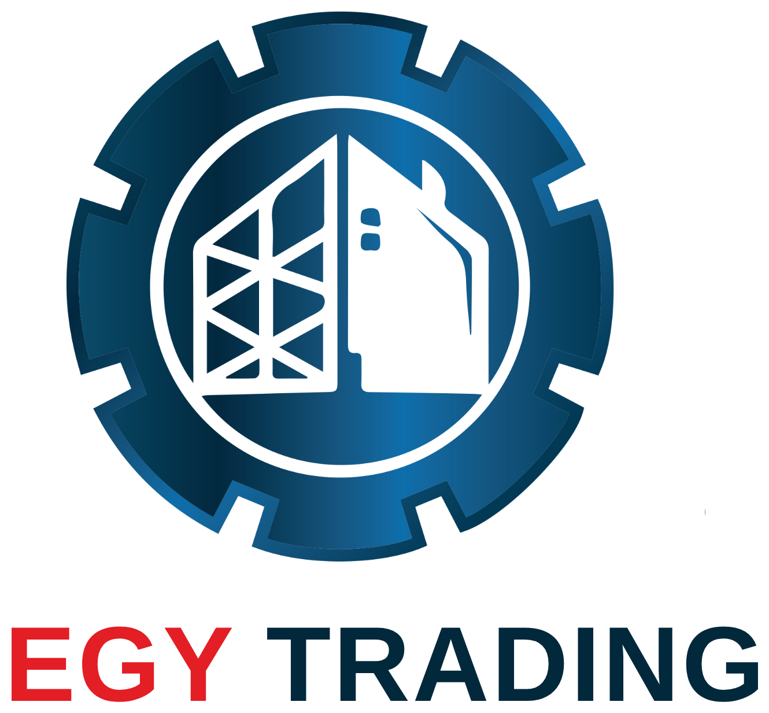
Egy Trading
Project RefRance
Address Office:10th of Ramadan City - District 12 - Building 146 - Apartment 6, 10th of Ramadan City, Egypt
Address Factory:Rubiki Factories Complex, Third Industrial Zone.

Slide 2
About Us
Egy Trading is a leading company specializing in engineering works, supplying, installing, and maintaining automatic doors and industrial air curtains in the Arab Republic of Egypt.
We are distinguished by our highly trained technical and engineering workforce, and our integrated team that meticulously supervises all processes, from construction to delivery, ensuring the highest quality and adherence to international engineering standards.

Slide 3











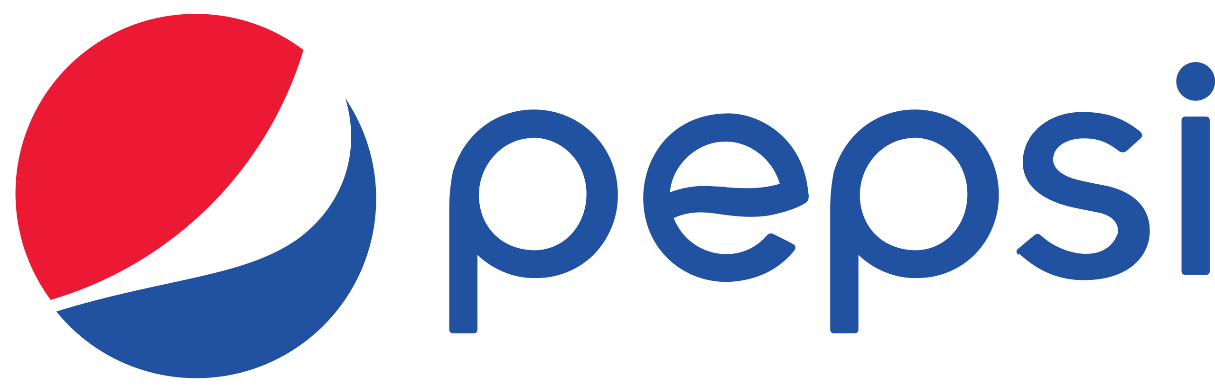
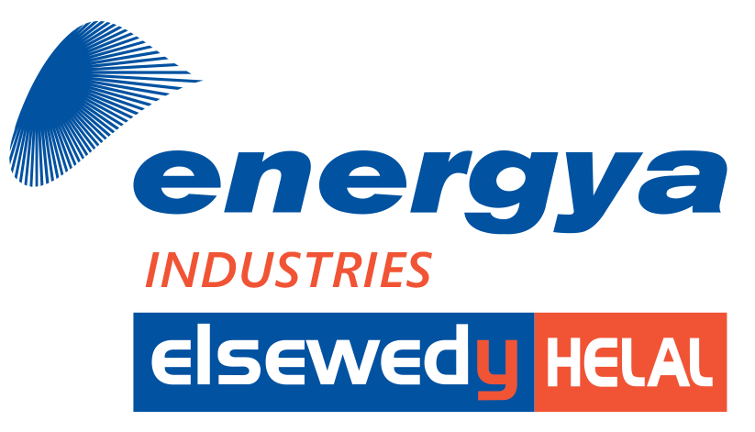

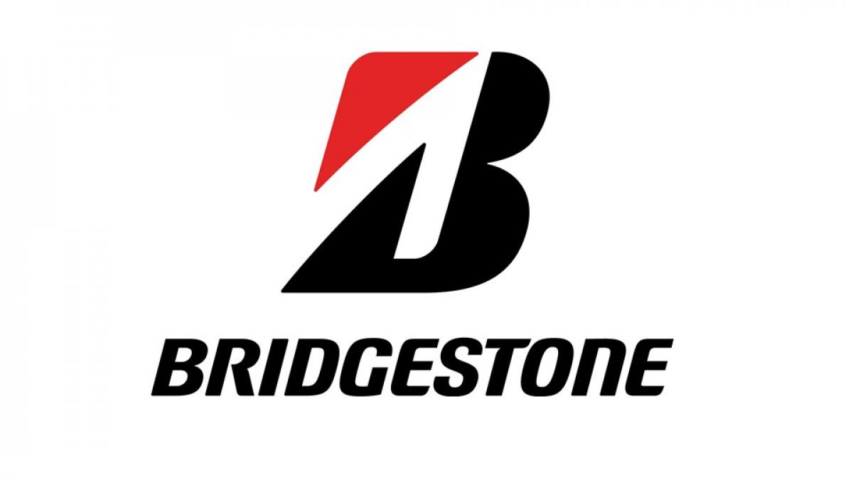

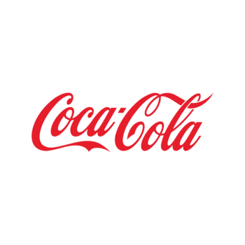
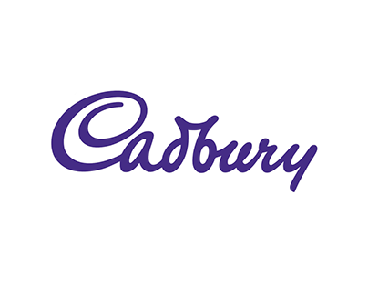




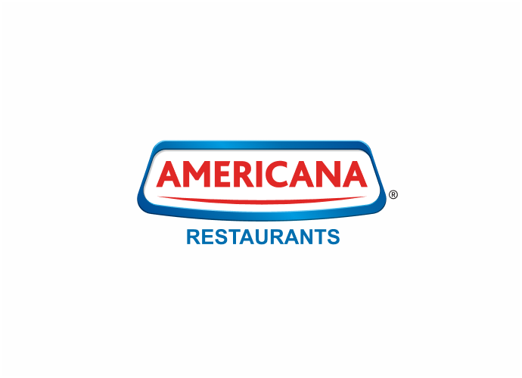
Our Customers

Slide 4
Our Vision & Core Values
EGY Trading is committed to providing smart engineering solutions that combine performance efficiency with the highest levels of safety and quality. We don't just aim to supply products, but to offer a sustainable strategic partnership that guarantees our clients a highly efficient, isolated, and protected working environment.
Our core values ​​that govern our work are: Absolute quality in materials, construction, and execution phases.
Full adherence to agreed-upon schedules and contracted specifications.
Continuous development of our technical staff's skills to keep pace with global advancements.

Slide 5
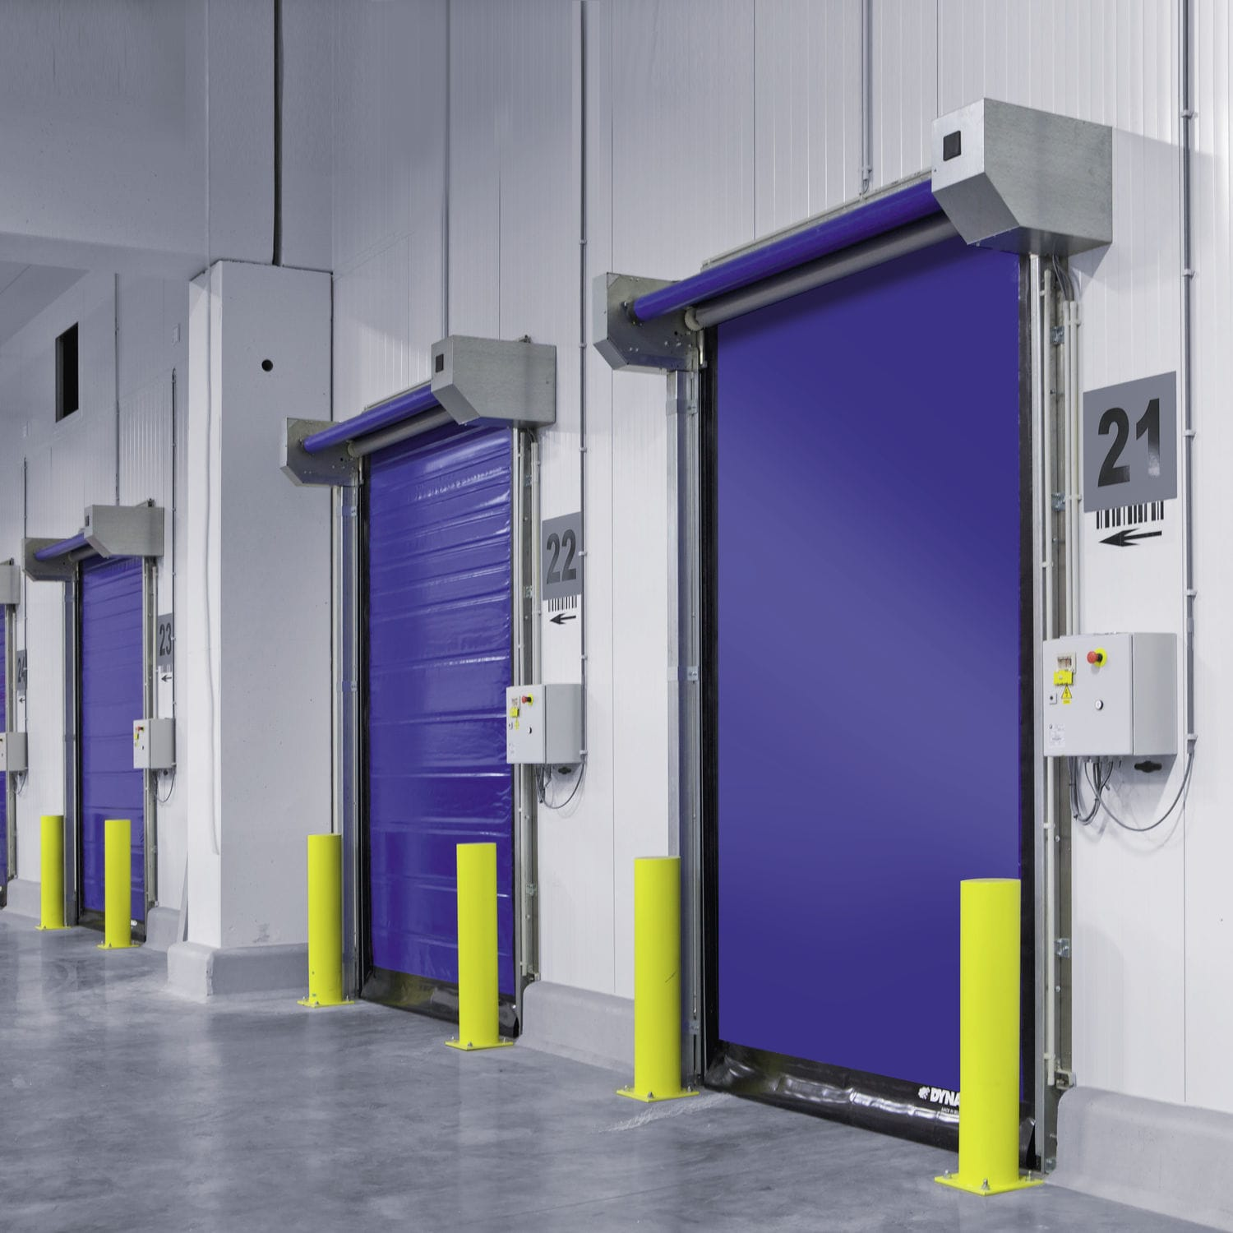
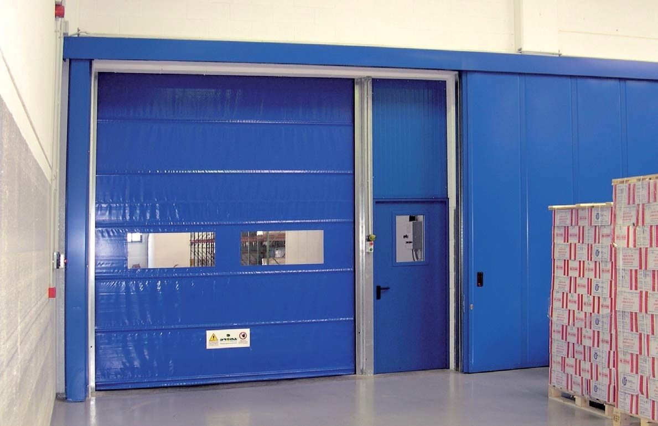
Cadbury – High-Speed Industrial Door
Supply and installation of a high-speed industrial door to improve operational efficiency and ensure smooth movement of personnel and equipment, while enhancing safety and environmental control within the facility.

Slide 6
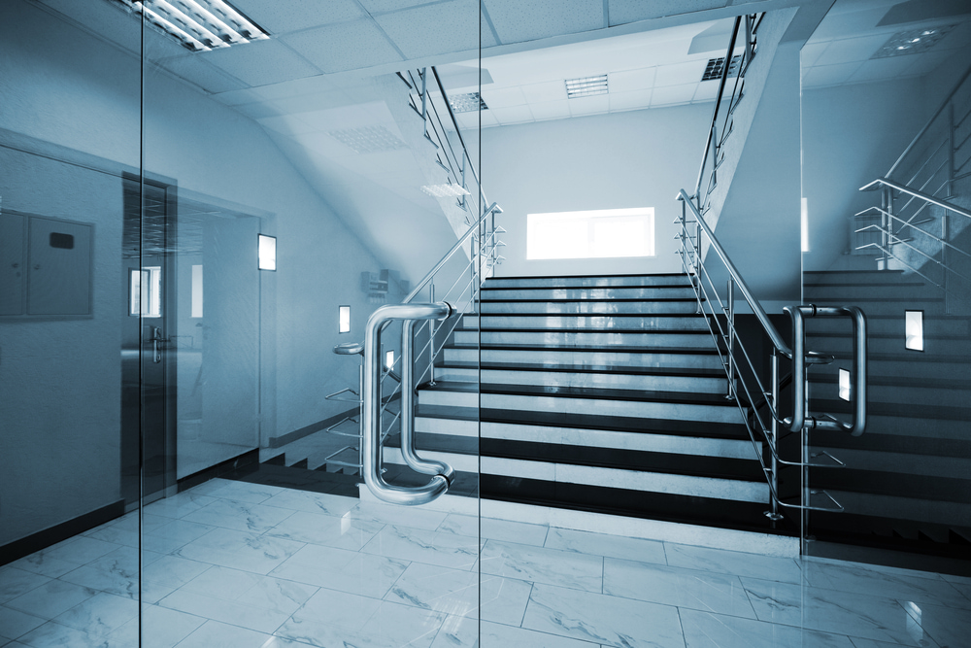
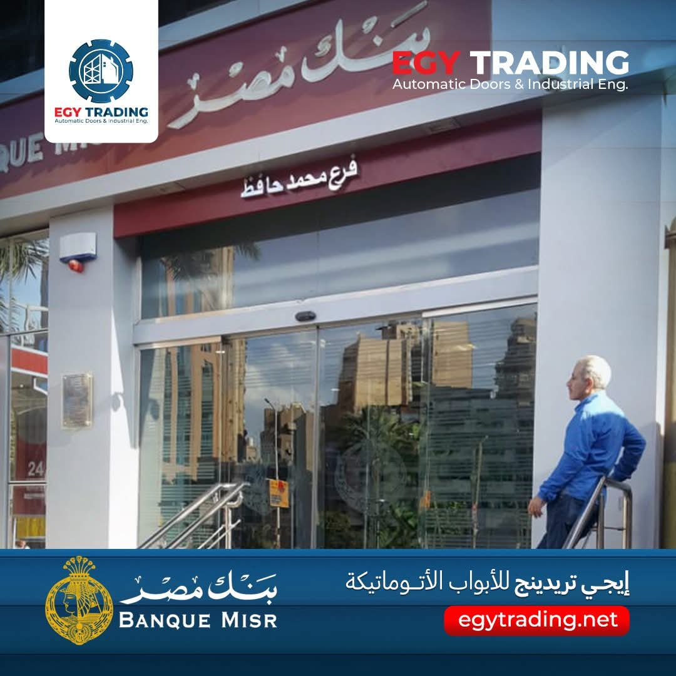
Banque Misr Entrance Automation
Executed the supply, installation, and integration of automated access doors, optimized for heavy daily traffic and safety compliance.

Slide 7
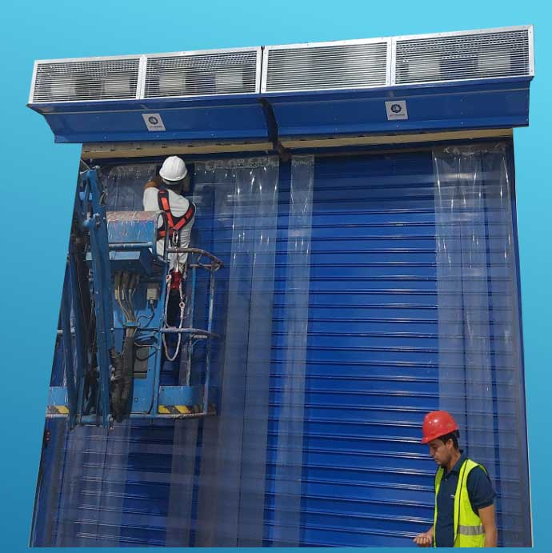
PepsiCo – Industrial Air Curtains Project
Supplied and installed high-capacity industrial air curtains for PepsiCo facilities to maintain indoor climate control, protect cleanliness, and optimize energy efficiency.

Slide 8
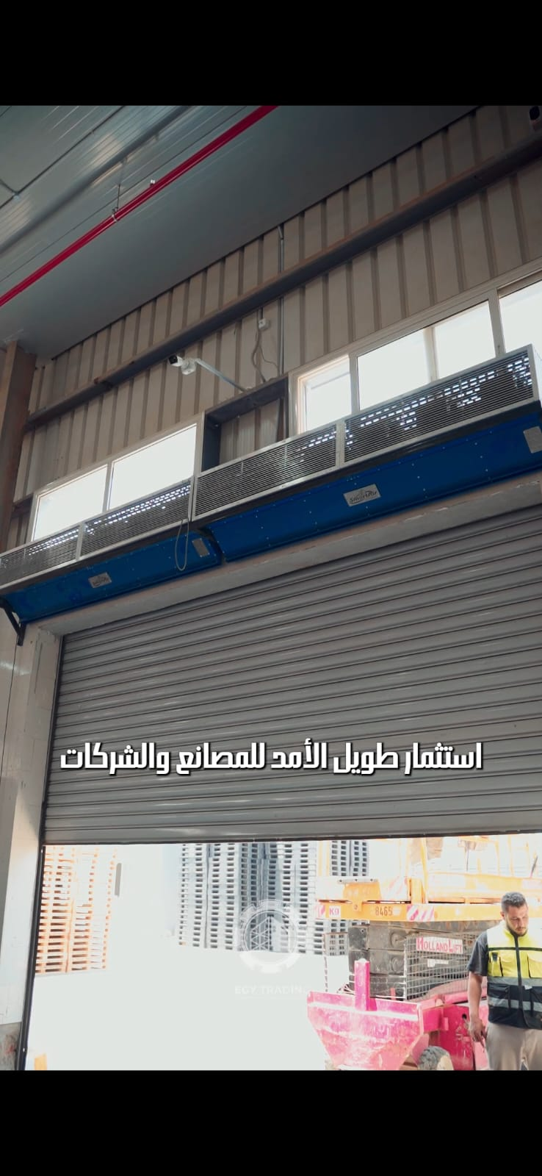
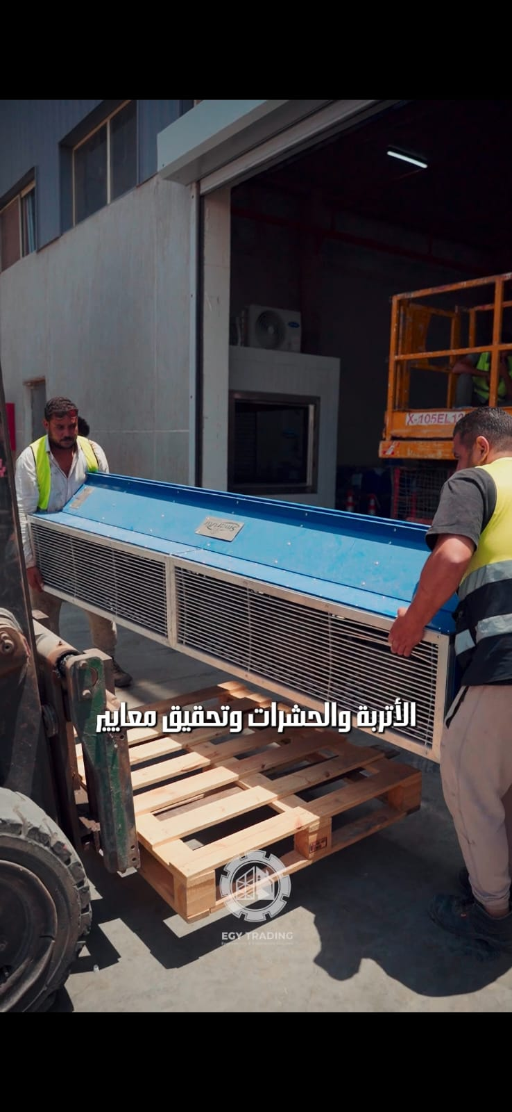
Snak Land Industrial Air Curtain Solutions
Delivered and mounted heavy-duty air curtains at PepsiCo plants, preventing dust and insect entry while reducing air conditioning power loss.

Slide 9
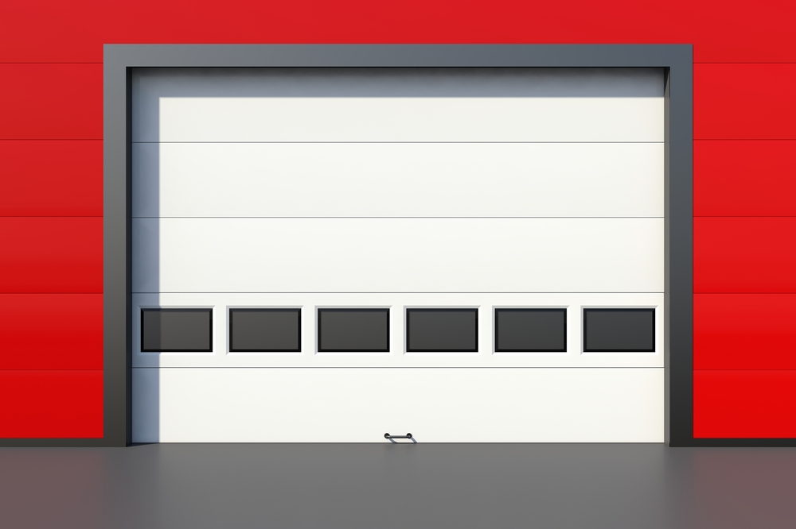
Americana Group – Sectional Industrial Overhead Doors Supplied and installed heavy-duty sectional overhead industrial doors for Americana Group facilities. Designed to provide optimal thermal insulation, high durability, and seamless operational flow for logistics and storage areas.

Slide 10
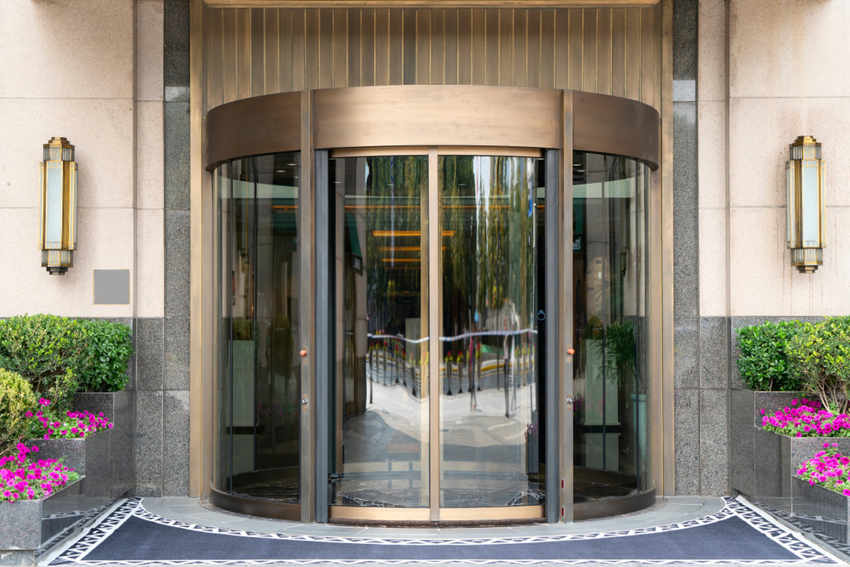
Tolip Hotel Main Entrance Automation Executed the supply, installation, and integration of elegant automatic revolving door systems for Tolip Hotel.
Engineered for smooth, continuous pedestrian flow, high safety standards, and superior architectural aesthetics.

Slide 11
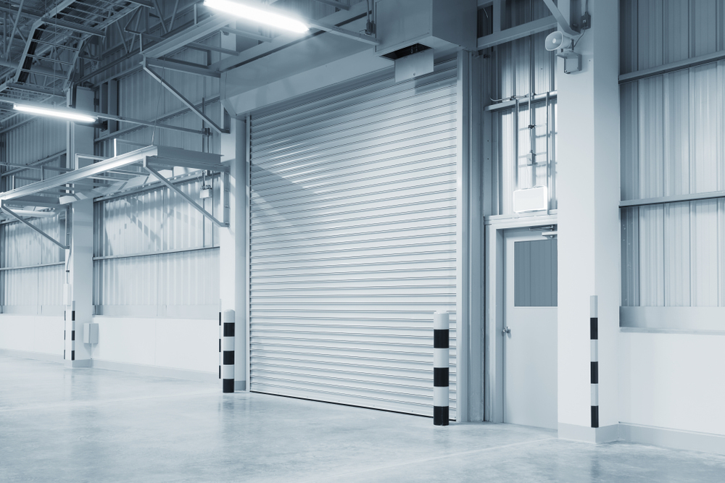
Cadbury – Industrial Roller Shutter Doors Project
Supplied and installed heavy-duty industrial motorized roller shutter doors for
Capri facilities. Engineered to provide maximum security, durability, and smooth operational flow for manufacturing and warehouse logistics.

Slide 12
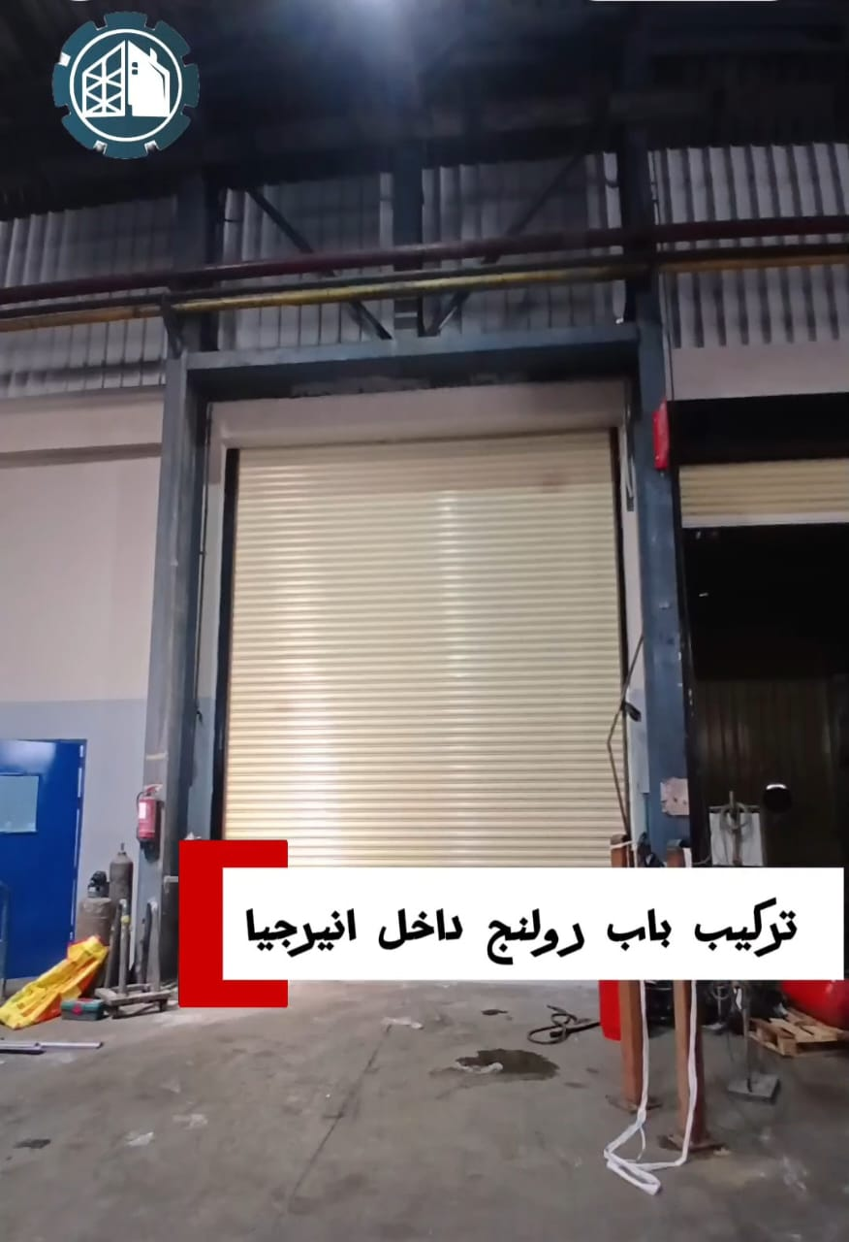
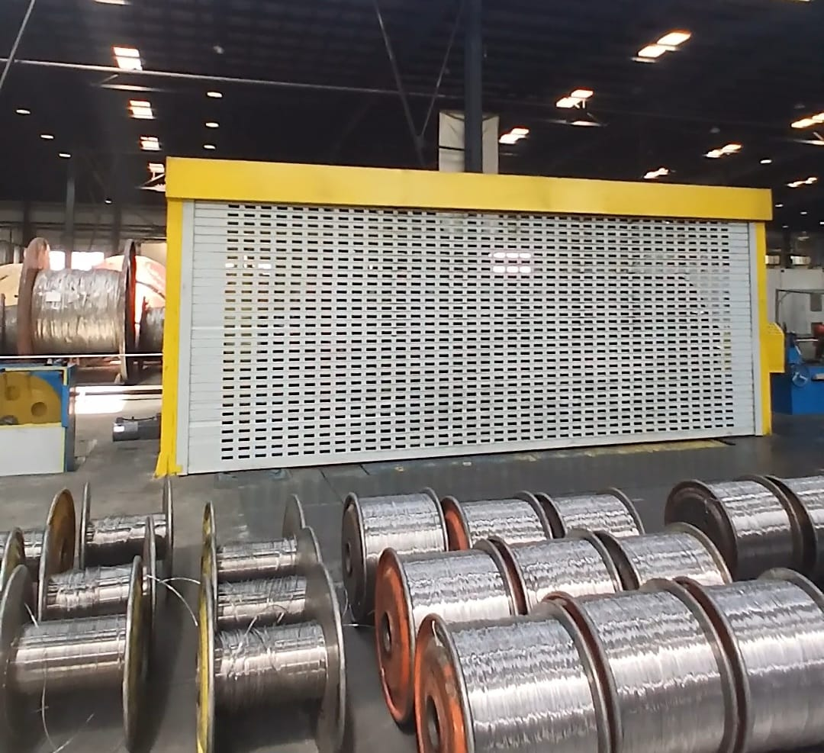
Energya– Industrial Roller Shutter Doors Project
Supplied and installed heavy-duty industrial motorized roller shutter doors for Capri facilities. Engineered to provide maximum security, durability, and smooth operational flow for manufacturing and warehouse logistics.

Slide 13
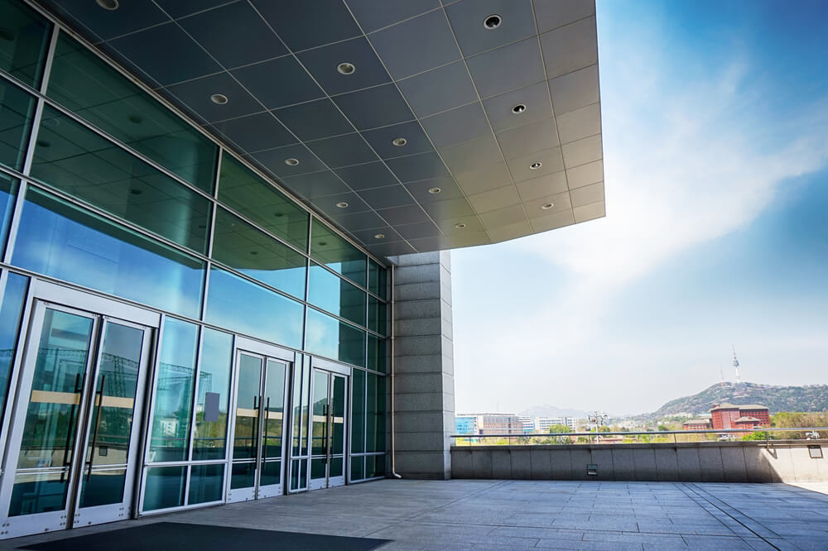
Amazon Facility Entrance Automation
Executed the supply, installation, and integration of automated commercial glass doors. Engineered for smooth access control, high safety standards, and optimal thermal insulation for high-footfall entrances.

Slide 14
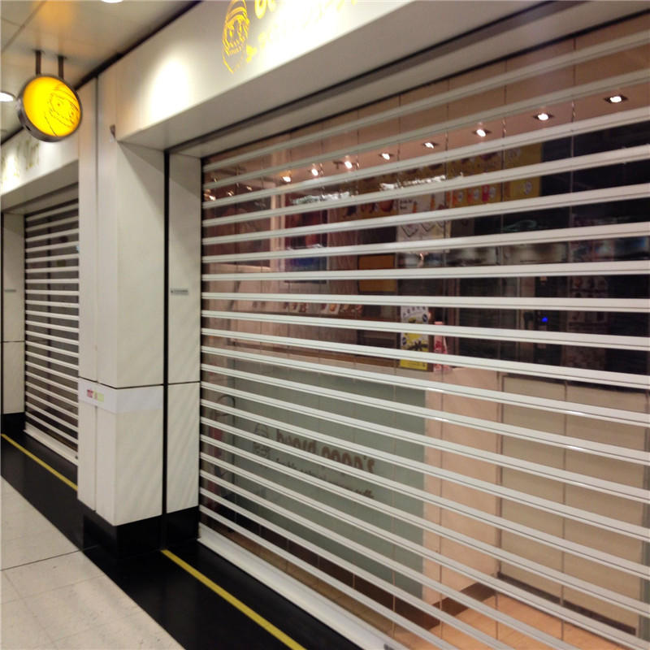
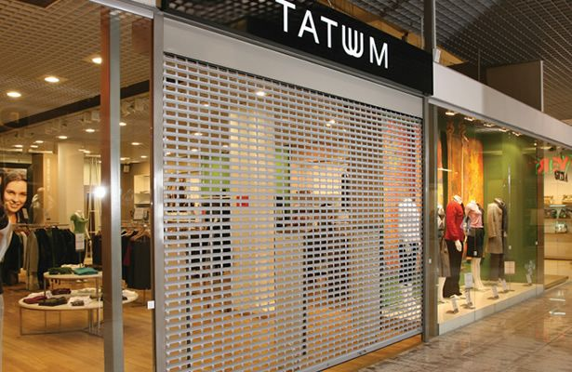
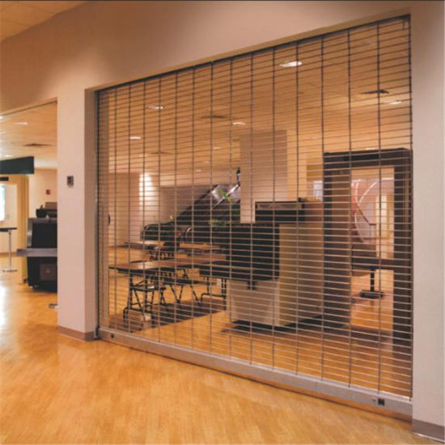
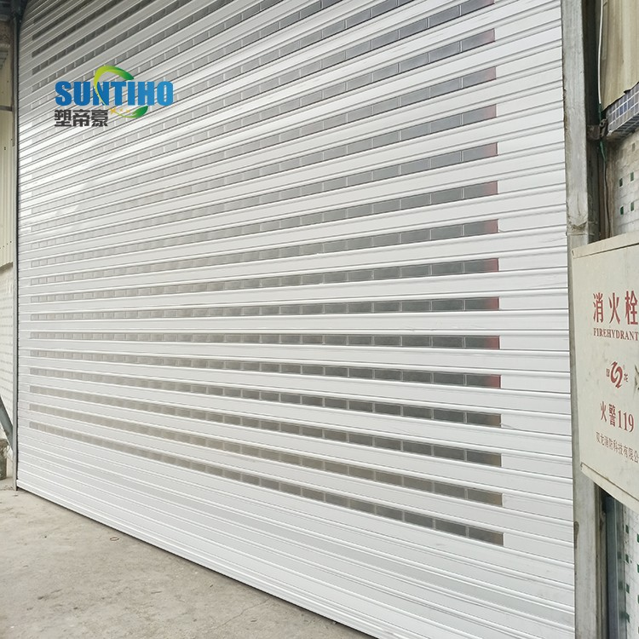
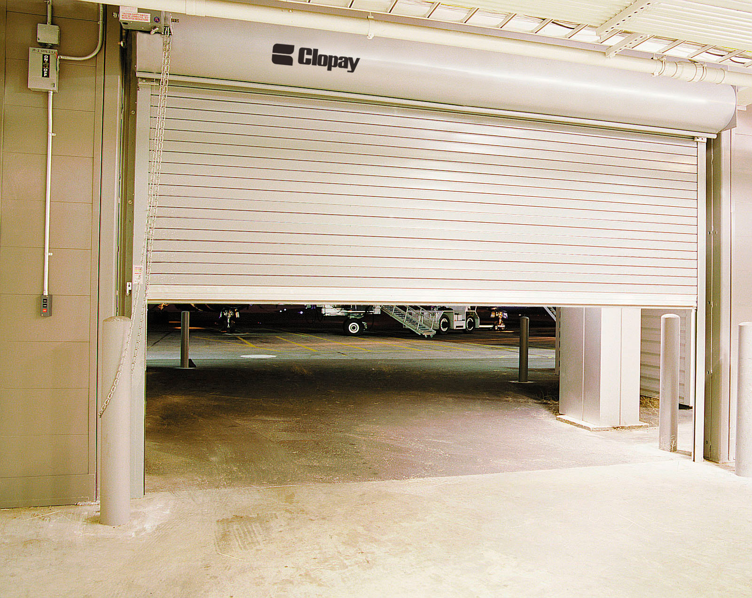
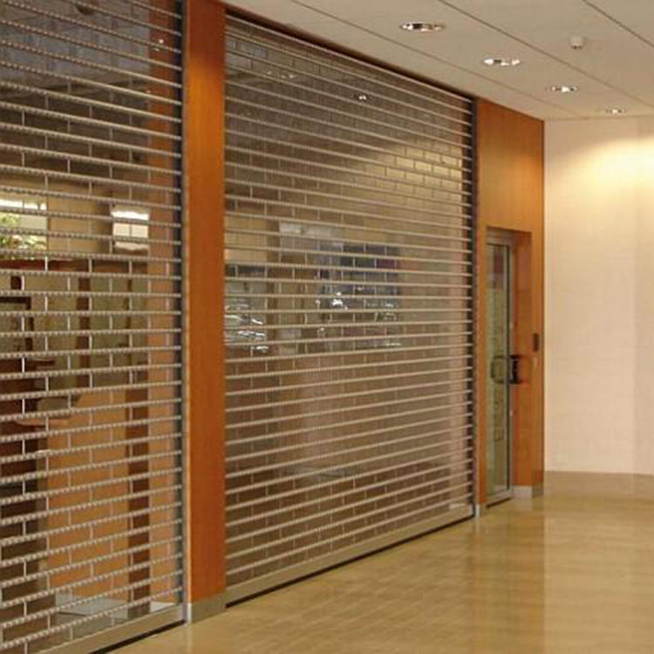
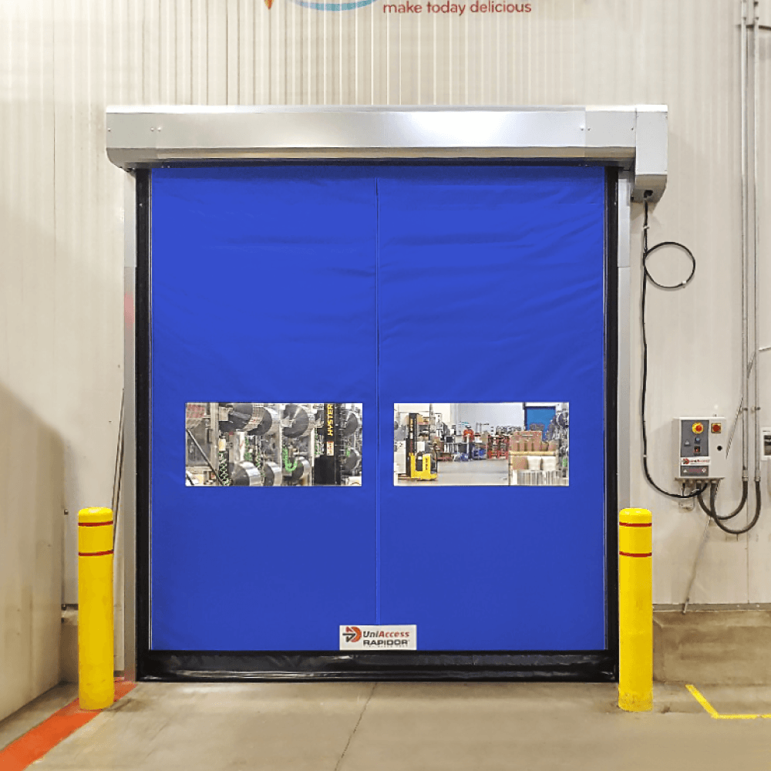
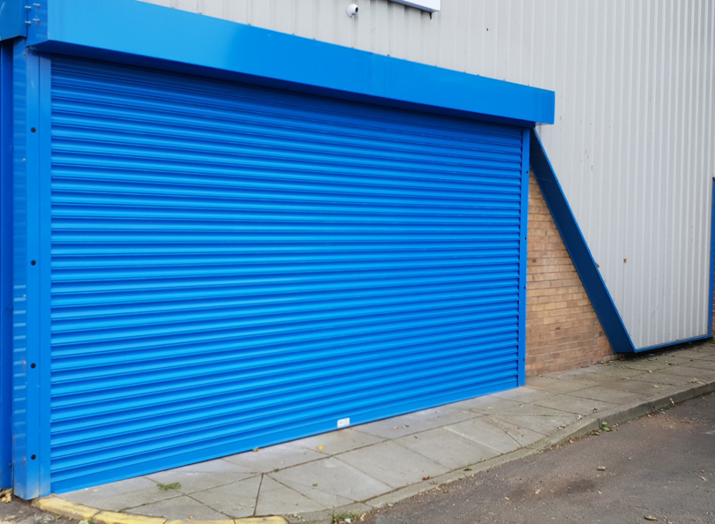
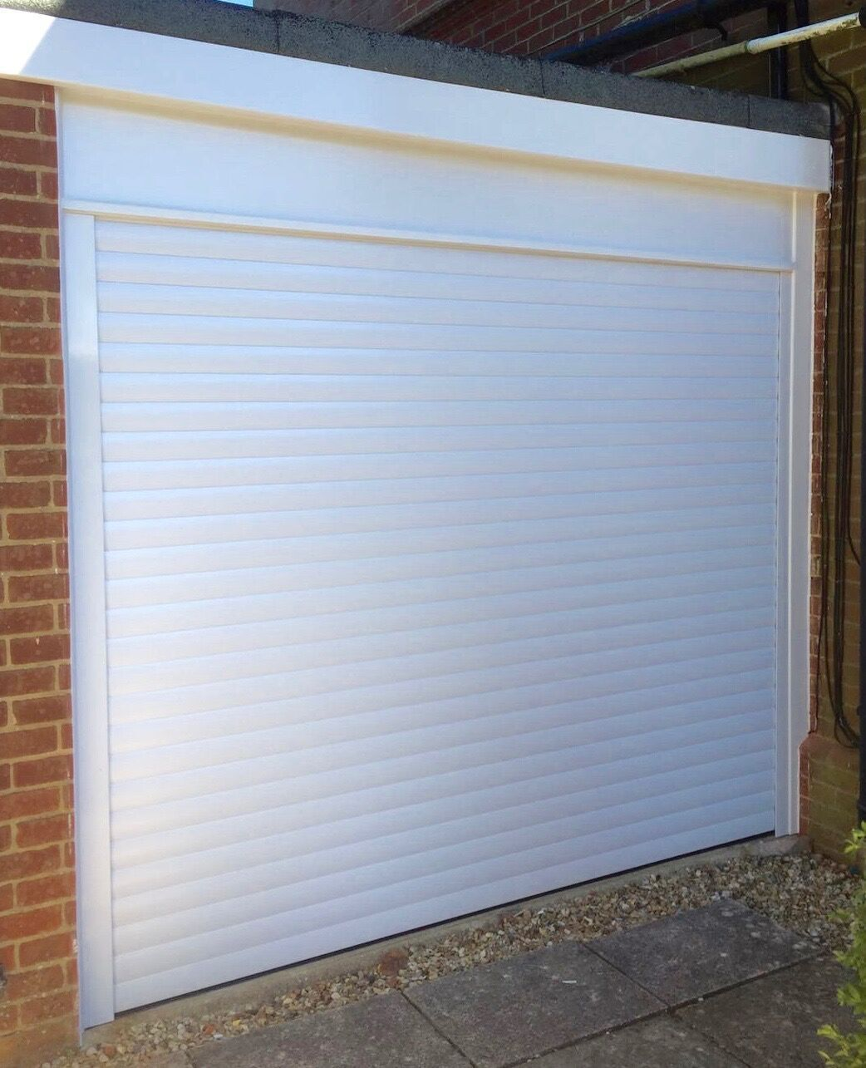
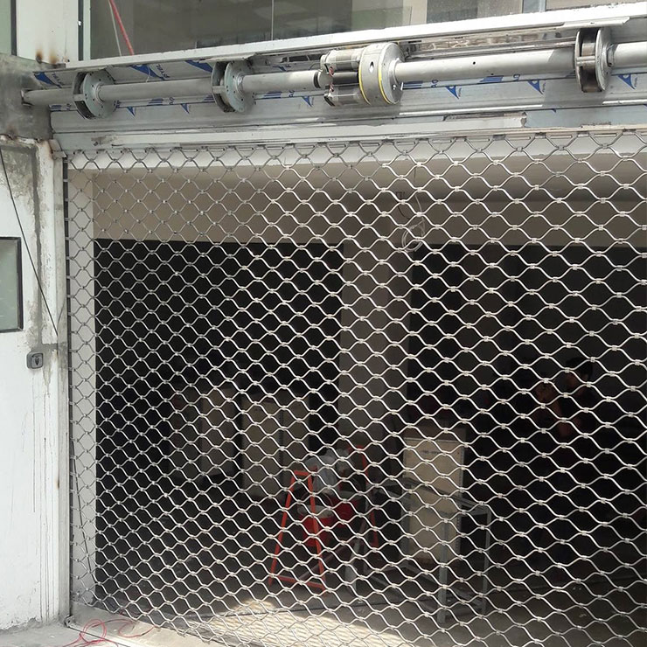
Our Projects

Slide 15
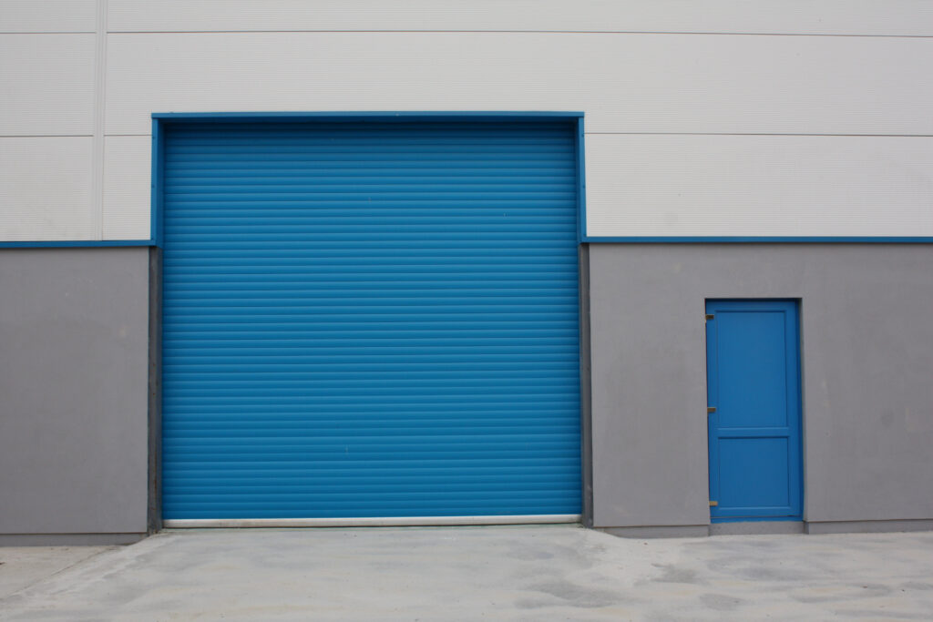
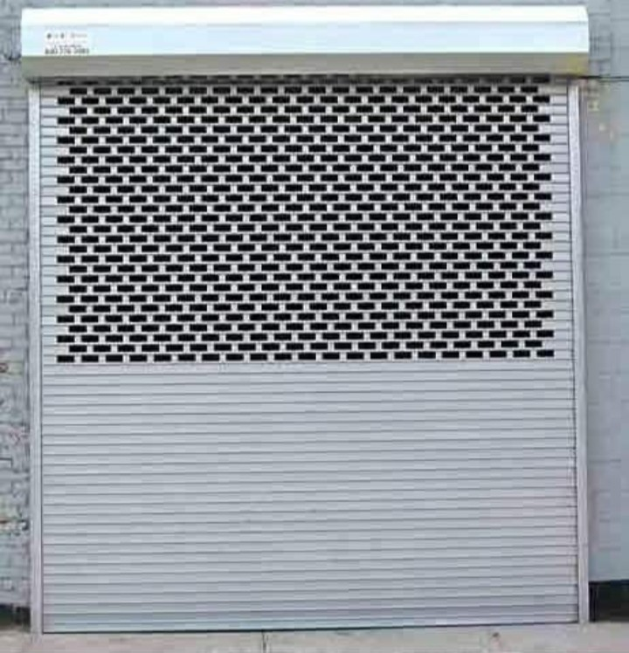
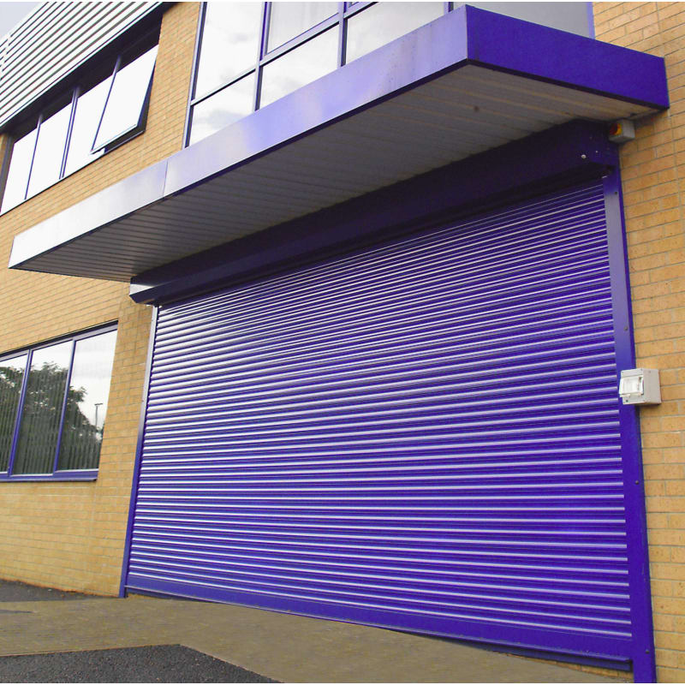
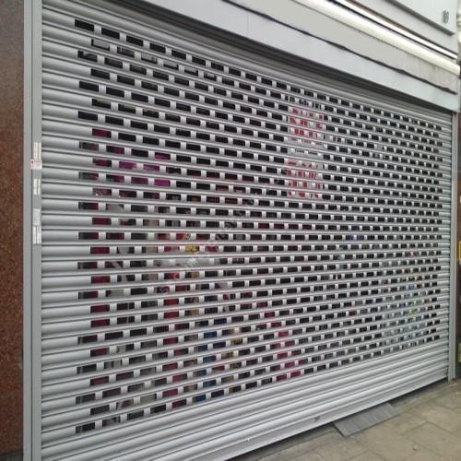
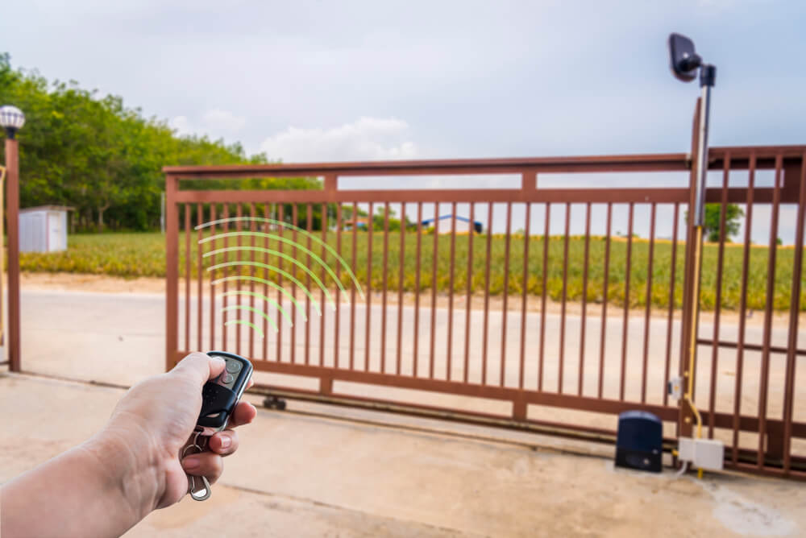
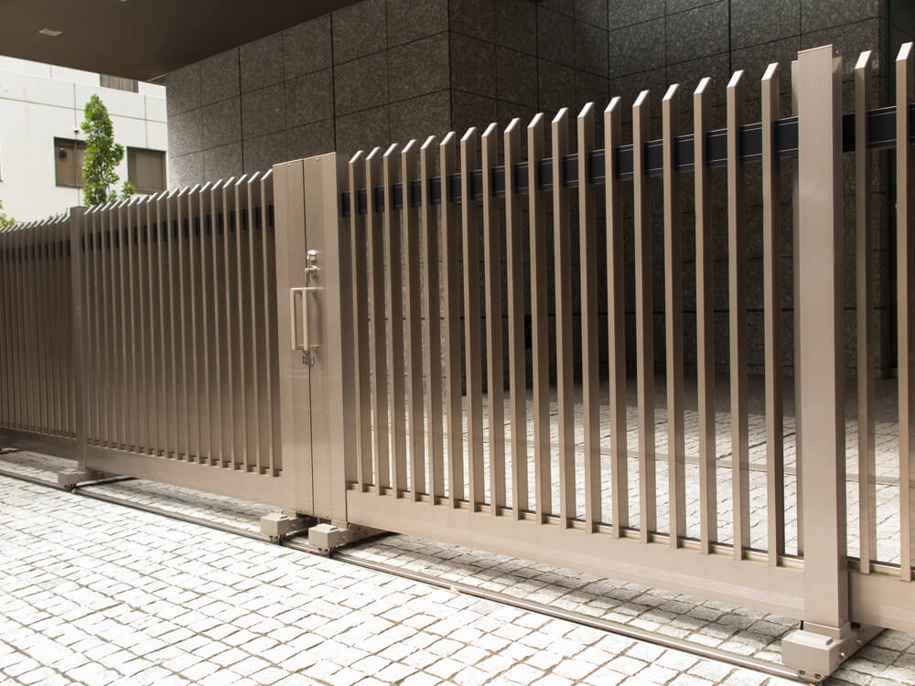
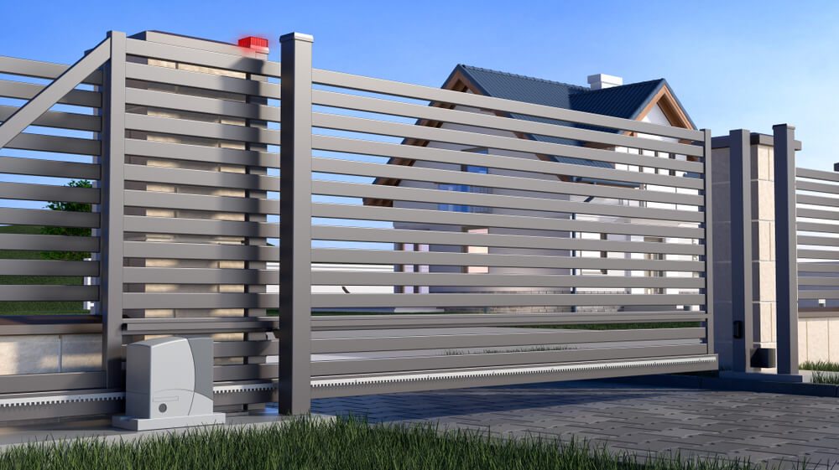
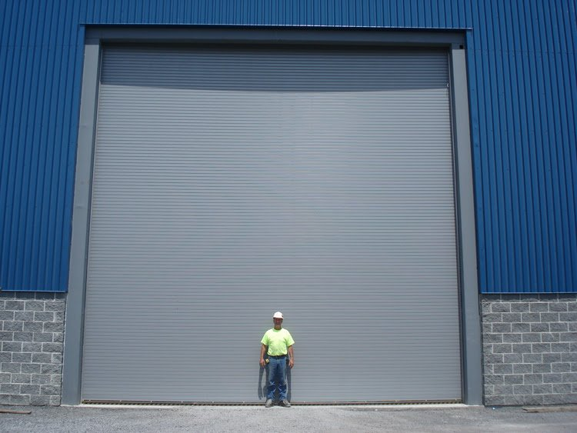
Our Projects

Slide 16
Why Egy Trading?
• Highly skilled technical and engineering staff: We have a team trained in the latest installation and maintenance methods for automatic doors and air curtains.
• Integrated follow-up and delivery team: We have engineers specializing in quality, construction, and project supervision to ensure complete delivery without any operational defects or deficiencies and in full engineering compliance.
• Close partnership with major entities: Our extensive portfolio of projects with sovereign entities, banks, and global companies such as Amazon and Pepsi is the best evidence of our commitment to the highest standards of accuracy and professionalism.
• Commitment to schedules and quality: We are fully committed to projects while maintaining high quality in all engineering details.
• Annual technical support and maintenance programs: We provide our clients with rapid after-sales service and support to ensure the continuous operation of their equipment and air curtains at peak efficiency throughout the year.
Contact Information

